Slide 1
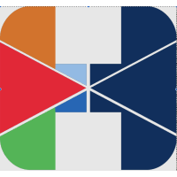
HAMOYE DECISION TREE
Blindness Detection (PP22/H605)
Presented by
Grace Effiong
Shivam Kesharwani

Slide 2
INTRODUCTION
SCOPE OF PROJECT: Health and Medicare
DR (Diabetic retinopathy) is an issue caused by the degeneration or progressive nature of diabetes mellitus, which damages the blood vessels at the back of the eye.
Recently, machine learning has become one of the most common techniques that has achieved better performance in many areas, especially in medical image analysis and classification. Convolutional neural networks are becoming more popular as a deep learning method in medical image analysis, and they are highly effective.
PROBLEM STATEMENT: Therefore being able to detect blindness before it occurs with the aid of a machine learning model is imperative to the detection of disease for early management and prevention.

Slide 3
PROCEDURES TAKEN
The following steps were taken to analyse the project
Interpretation of Results
Data Exploration
Modelling

Slide 4
DATA EXPLORATION
We have aptos-2019-Blindness-Detection Dataset from Kaggle consisting of 3662 labelled dataset in train.csv having features id_code and diagnosis with no missing data.
We also have 1928 unlabeled dataset test.csv dataset.
The images are labelled by a clinical expert. The integer labels indicate the severity of DR on a scale from 0 to 4, where 0 indicates no disease and 5 is the proliferative stage of DR.
Notes:
0-No DR , 1-Mild DR, 2-Moderate DR, 3-Severe DR, 4-Proliferative DR

Slide 5
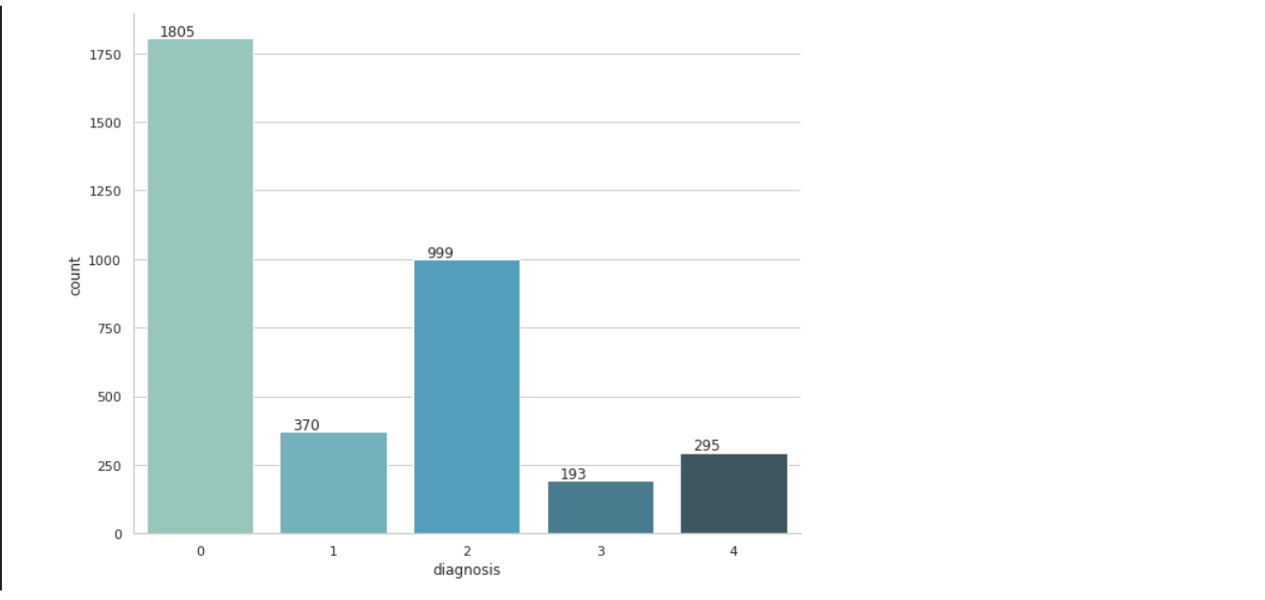
LABELLED DATA REPORT
The dataset has 1805 images with No DR ,370 with mild DR, 999 with moderate DR,193 with severe DR and 295 with Proliferative DR which is visualized in the graph above.

Slide 6
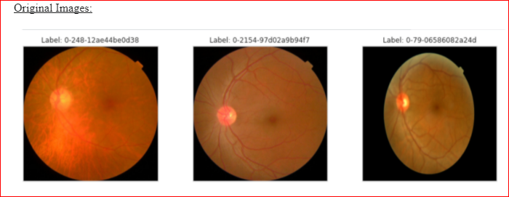
IMAGE ANALYSIS
The following EDA was done on the images as we need to feed the same size, shape and dimension of images in the same format, we resize the images into (512, 512).

Slide 7
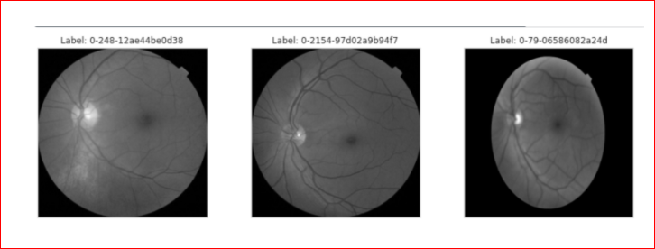
Green Channel Separation:
Green Channel of the three colour channels in the image (Red, Green, and Blue) is done and the contrast between the blood vessels, exudates and haemorrhages is best seen in the green channel and these channels are neither under- illuminated nor over-saturated.

Slide 8
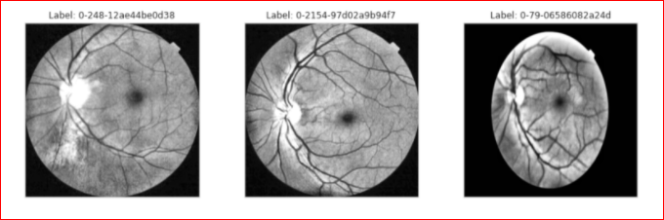
CLAHE:
Contrast Limited AHE (CLAHE) is a variant of adaptive histogram equalization in which the contrast amplification is limited, so as to reduce this problem of noise amplification. In CLAHE, the contrast amplification in the vicinity of a given pixel value is given by the slope of the transformation function.

Slide 9
MODELLING
We employed one of the CNN architecture that is ResNet50. Residual learning can be explained with a very simple example. Initially when we learn to ride a bike we make mistakes and we learn. Once we are able to ride the bike, our brain has stopped firing the neurons responsible to learn the skill allowing us to focus on other things involved with riding the bike. The ResNet50 architecture does not need to fire all neurons in every epoch. This greatly reduces the training time and improves accuracy. Once a feature is learnt, it does not try to learn it again but rather focuses on learning newer features. A very smart approach that greatly improved model training performance.

Slide 10
Residual learning can be explained with a very simple example. Initially when we learn to ride a bike we make mistakes and we learn. Once we are able to ride the bike, our brain has stopped firing the neurons responsible to learn the skill allowing us to focus on other things involved with riding the bike. The ResNet50 architecture does not need to fire all neurons in every epoch. This greatly reduces the training time and improves accuracy. Once a feature is learnt, it does not try to learn it again but rather focuses on learning newer features. A very smart approach that greatly improved model training performance.

Slide 11
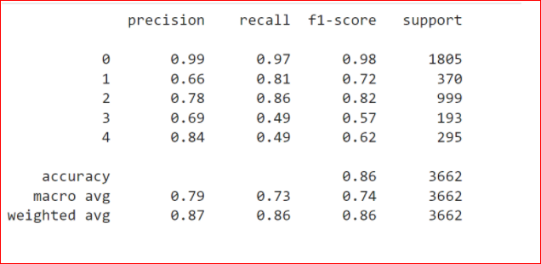
Model Evaluation: Model evaluation is important to assess the efficacy of a model during initial research phases, and it also plays a role in model monitoring.

Slide 12
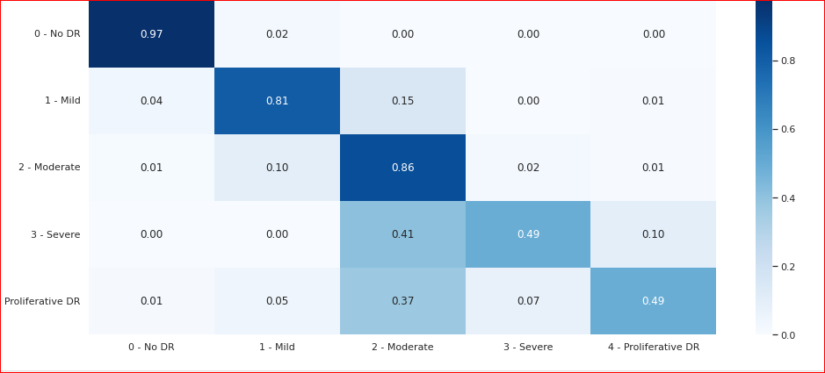
Confusion matrix

Slide 13
RESULT After applying our Model on Test Dataset consisting 1928 images, Model prediction shows
SEVERITY | TOTAL
Proliferative DR | 46
Severe DR | 331
Moderate DR | 964
Mild DR | 292
No DR | 295

Slide 14
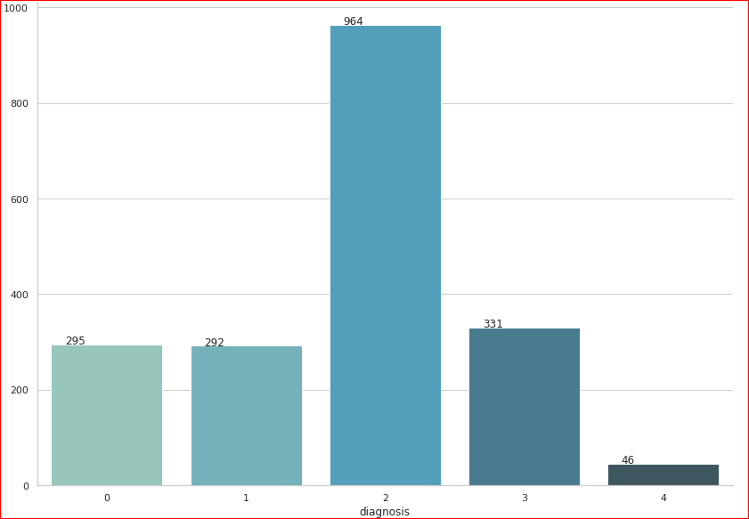
RESULT VISUALIZATION

Slide 15
CONCLUSION
In this project, we presented an automated Diabetic Retinopathy detection system, based on lightweight deep learning. Initially, a dataset of fundus images was rearranged, and augmented to improve the dataset to feed the deep network.
The developed model focused on investigating different layers, activation function, loss function, and optimization algorithms for minimizing the computational cost without sacrificing the model accuracy.
Our model performance in detection of Diabetic Retinopathy in terms of training accuracy (96.17%), validation accuracy (80.49%), being highly accurate, cost- and time-efficient enabled.
This would help ophthalmologists to detect Diabetic retinopathy to prevent blindness more timely and more precisely.

